Slide 1
DevOps in the Cloud for the .NET Developer
Scott Addie
Senior Content Developer
@Scott_Addie

Slide 2
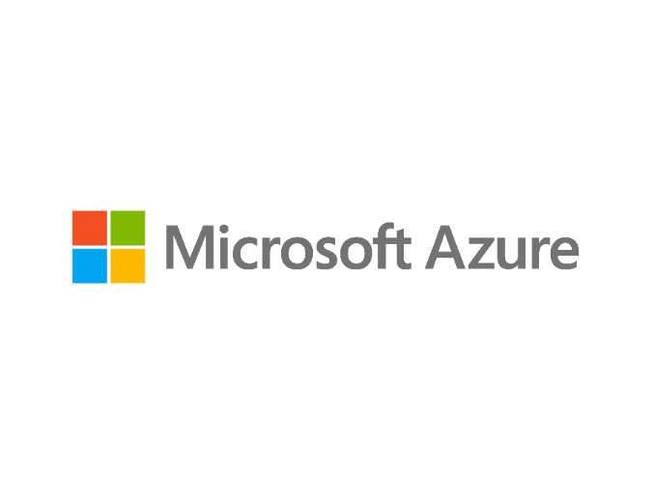
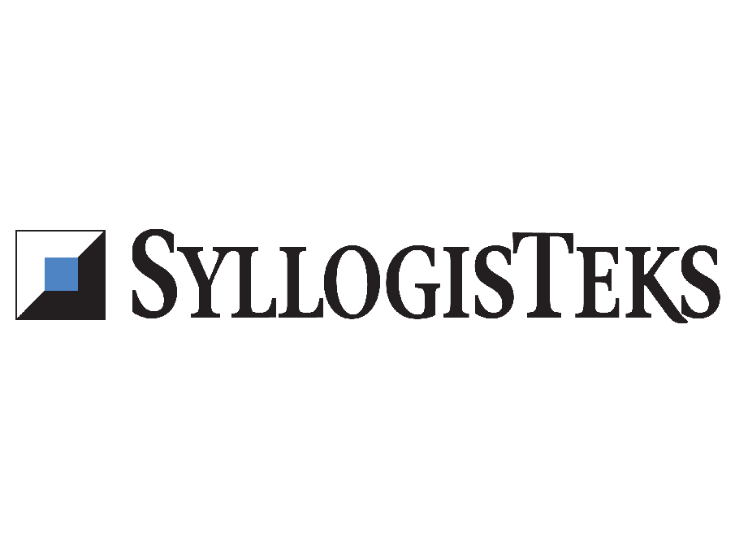
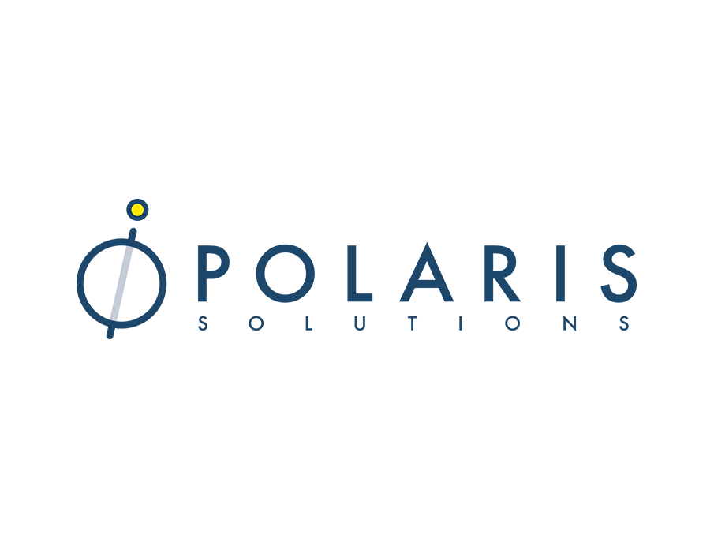



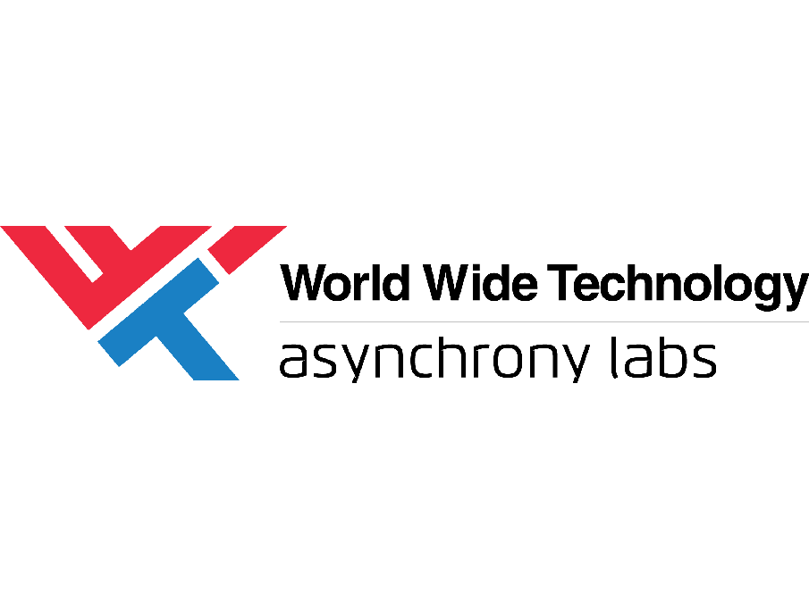
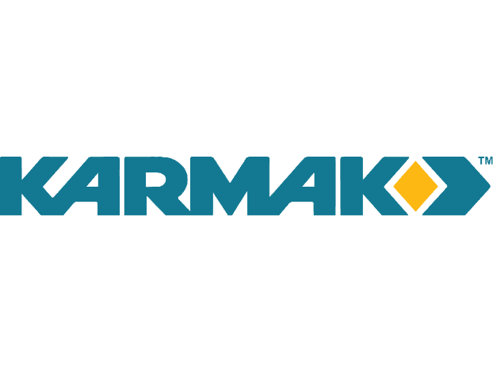



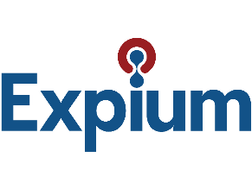
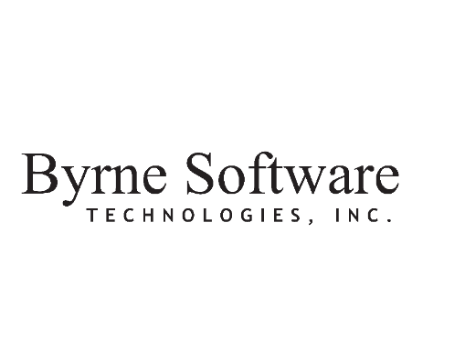
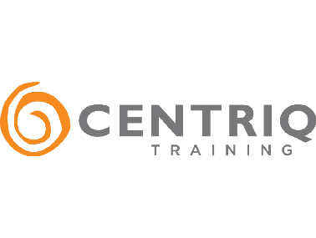

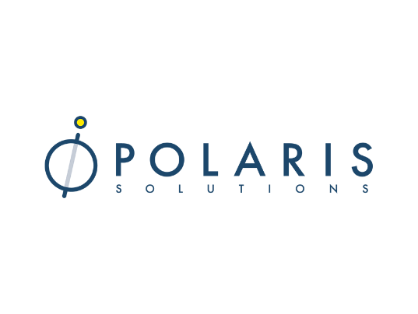
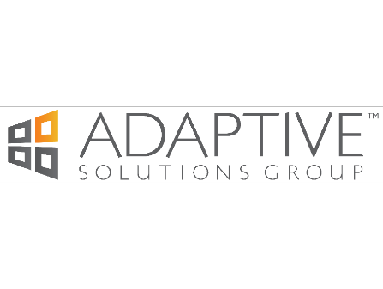



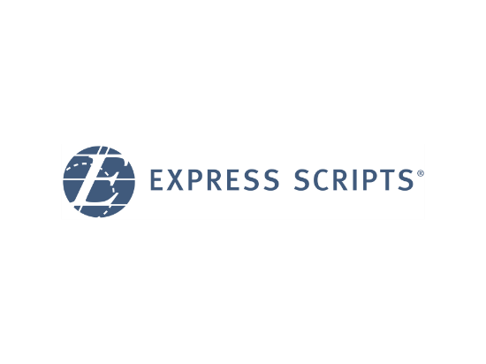
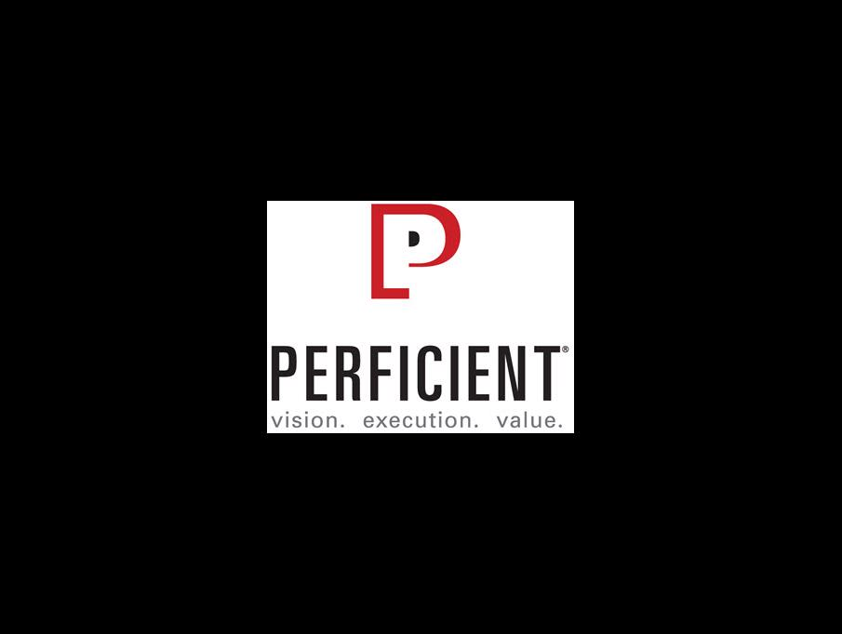


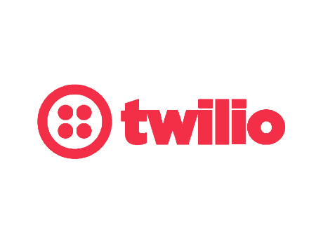
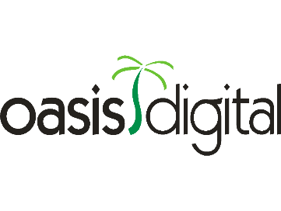



Swag Bags
Platinum Sponsors
Lanyards
Party
Gold Sponsors
Notebooks
Media

Slide 3
Agenda
DevOps overview
Right-click > Publish
Azure Pipelines
Build pipeline
Unit testing
Code coverage
Release pipeline
Blue-green deployments
Stakeholder approvals
Demo

Slide 4

What is DevOps?
Developers, Operations, QA
People
Products
Process
…the union of people, process, and products to enable continuous delivery of value to our end users. – Donovan Brown, Microsoft
Continuous Build & Delivery
DevOps
Azure DevOps Services
Notes:
People following a process enabled by products to deliver value to end users

Slide 5



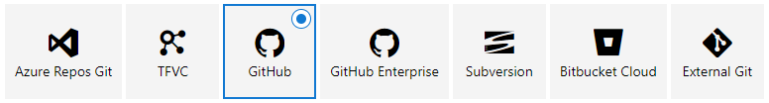
A basic DevOps CI/CD pipeline
Code repo
Build tasks
Release tasks
C#
Notes:
Build systems:
Jenkins
TeamCity
Bamboo
TFS
Build tasks:
Package restore
Versioning
Linting
Packaging artifacts for deployment

Slide 6

The fallacy of right-click > Publish
Doesn’t scale beyond 1 person
VS IDE lock-in
Local dependencies may differ from prod
Steps are forgotten
The school bus factor
Notes:
Containers solve deps. Problem
“A low bus factor of 1 represents a single point of failure within the team.”

Slide 7





Introducing Azure DevOps
Azure Boards
Azure Pipelines
Azure Repos
Deliver value to your users faster using proven agile tools to plan, track, and discuss work across your teams.
Build, test, and deploy with CI/CD that works with any language, platform, and cloud. Connect to GitHub or any other Git provider and deploy continuously.
Get unlimited, cloud-hosted private Git repos and collaborate to build better code with pull requests and advanced file management.
Azure Test Plans
Azure Artifacts
➔
Test and ship with confidence using manual and exploratory testing tools.
Create, host, and share packages with your team, and add artifacts to your CI/CD pipelines with a single click.
azure.com/devops
Notes:
Launched on 9/10
VSTS split into 5 independent services
Azure Pipelines being used by:
Atom
TypeScript
VS Code

Slide 8

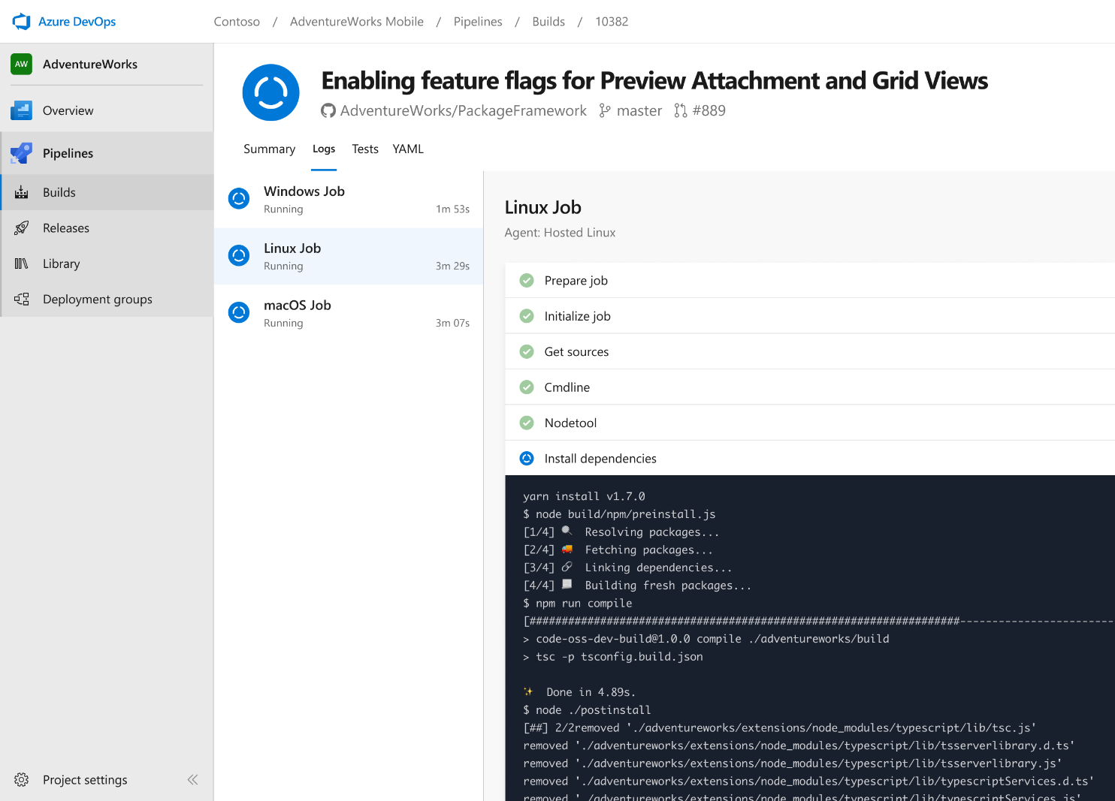


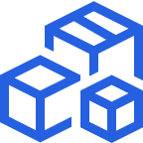

Azure Pipelines
Cloud-hosted pipelines for Linux, Windows and macOS, with unlimited minutes for open source
Any language, any platform, any cloud
Build, test, and deploy Node.js, Python, Java, PHP, Ruby, C/C++, .NET, Android, and iOS apps. Run in parallel on Linux, macOS, and Windows. Deploy to Azure, AWS, GCP or on-premises
Extensible
Explore and implement a wide range of community-built build, test, and deployment tasks, along with hundreds of extensions from Slack to SonarCloud. Support for YAML, reporting and more
Containers and Kubernetes
Easily build and push images to container registries like Docker Hub and Azure Container Registry. Deploy containers to individual hosts or Kubernetes.
Best-in-class for open source
Ensure fast continuous integration/continuous delivery (CI/CD) pipelines for every open source project. Get unlimited build minutes for all open source projects with up to 10 free parallel jobs across Linux, macOS and Windows
➔
azure.com/pipelines
Notes:
Automates builds & deployments so you spend less time with the nuts and bolts and more time being creative

Slide 9


Azure Pipelines
Microsoft Open Source
Private Projects:
1,800 free build mins. / mo.
1 free parallel job
1 free parallel job for VS Enterprise Subscribers
Public Projects:
Free, unlimited build mins.
10 free parallel jobs across Windows, Linux, and macOS
➔
azure.com/pipelines

Slide 10











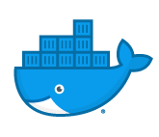
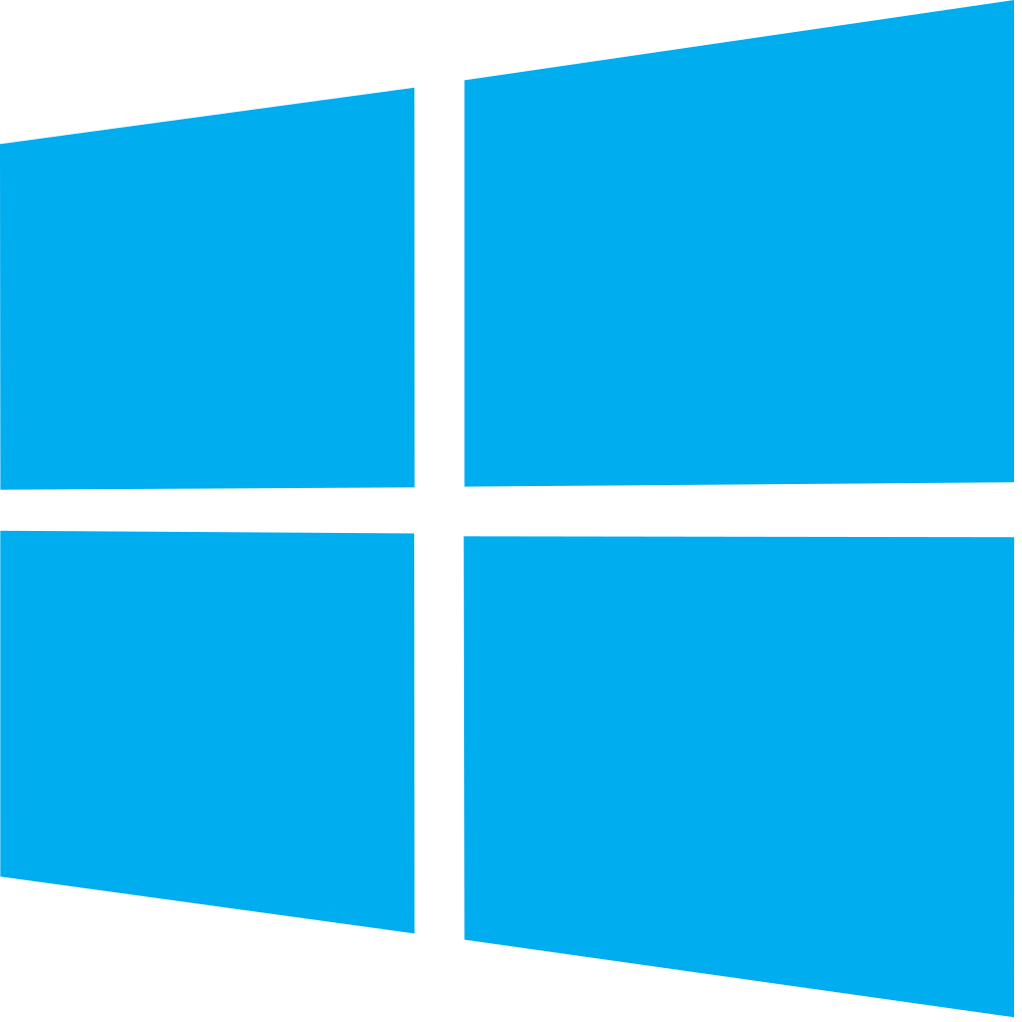


Azure DevOps: Choose the tools and clouds you love
Azure DevOps lets developers choose the tools that are right for them
Mix and match to create workflows with tools from Microsoft, open source or your favorite 3rd party tools
Target any cloud, on-prem, or both and deploy to the servers you need
Notes:
Build & release tasks in marketplace
On-prem deployments too

Slide 11

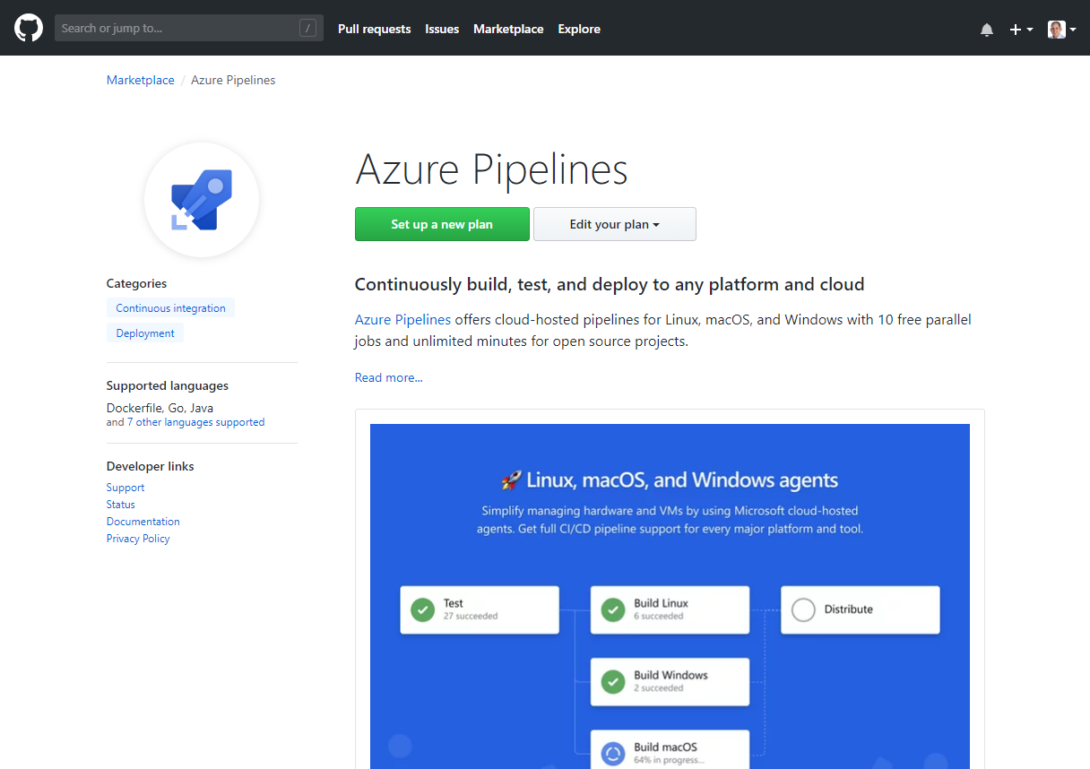
Integrated with GitHub
Azure Pipelines available now to any developer from the GitHub Marketplace
➔
github.com/marketplace/azure-pipelines
Notes:
Install GitHub App in repo
Build activity visible on Checks tab of PR

Slide 12
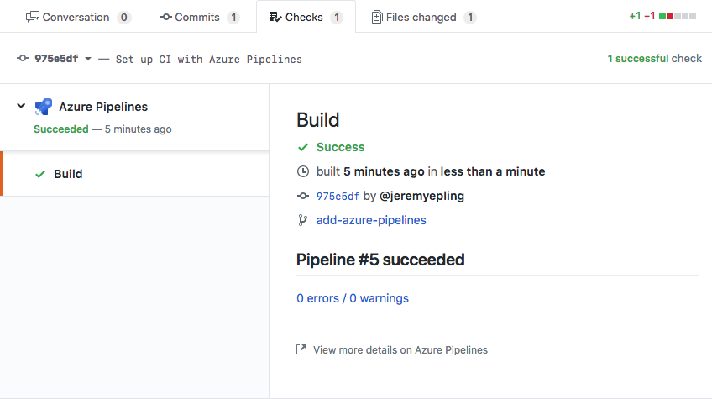
GitHub integration

Slide 13
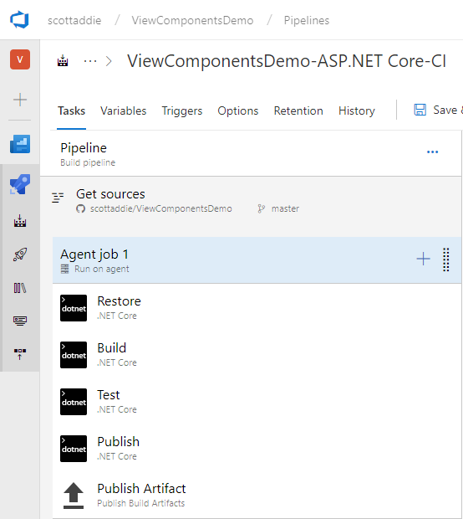
Build pipeline
No knowledge of environments
Build once, deploy anywhere
Run unit tests & publish outcome
Analyze code coverage
Package up artifacts
Use UI or YAML
Notes:
Visual designer or “pipeline as YAML”

Slide 14
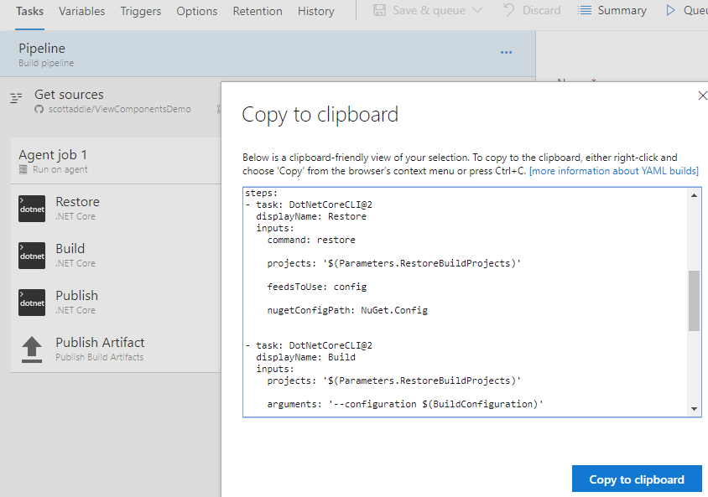
Build pipeline construction
Notes:
YAML is a 1st-class citizen

Slide 15
Hosted build agents
No maintenance or upgrades to think about
5 VM images w/ .NET Core SDK preinstalled:
Ubuntu 16.04
VS 2017 on Win Server 2016
macOS 10.13
Win Server 1803 (for running Windows containers)
VS 2015 on Win Server 2012R2
➔
github.com/Microsoft/azure-pipelines-image-generation
Notes:
https://docs.microsoft.com/azure/devops/pipelines/agents/hosted?view=vsts&tabs=yaml
https://github.com/Microsoft/azure-pipelines-image-generation/blob/master/images/win/Vs2017-Server2016-Readme.md
- Latest .NET Core components installed:
- 2.1.2 runtime
- 2.1.400 SDK

Slide 16


Self-hosted build agents
Ideal if you require custom build pre-requisites, control vendor license keys, etc.
Can create in cloud or on-prem
Can deploy to on-prem servers from Azure DevOps
Can use deployment groups to dynamically provision to target deployment group types
Default
Hosted
Microsoft Hosted Agents
Self-Hosted Agents
Target on-premises environment
© Microsoft Corporation

Slide 17
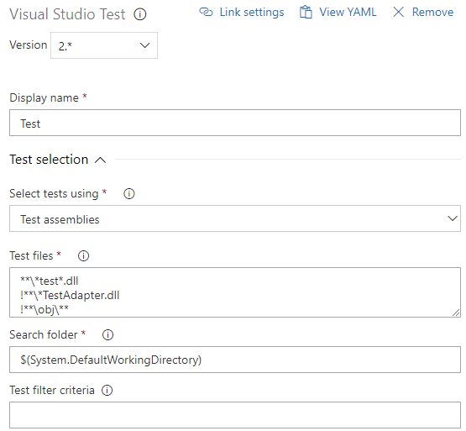
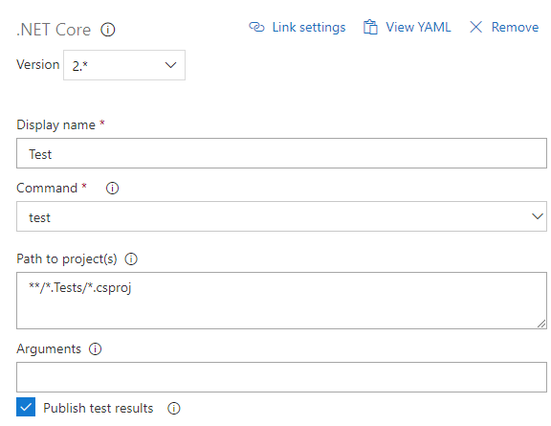
Unit testing & code coverage: Windows only
Choose one of the following tasks:
Visual Studio Test (VSTest@2)
.NET Core (DotNetCoreCLI@2)
Notes:
Use case:
ASP.NET Core targeting .NET Framework

Slide 18
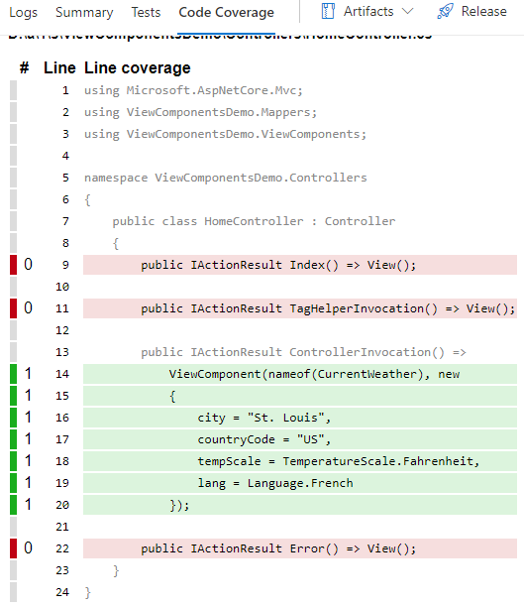
Unit testing & code coverage: Cross-platform
Support for Linux, macOS, & Windows
.NET Core (DotNetCoreCLI@2)
Coverlet
ReportGenerator
➔
github.com/tonerdo/coverlet
➔
github.com/danielpalme/ReportGenerator
Notes:
Use case:
ASP.NET Core targeting .NET Core

Slide 19
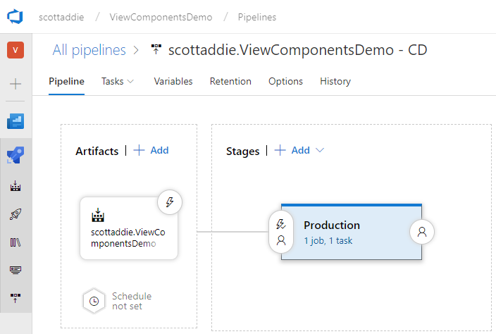
Release pipeline
Has knowledge of environments
Deploy artifacts produced by build
Run integration tests
Triggers
Pre- & post-approvers
Build completion

Slide 20
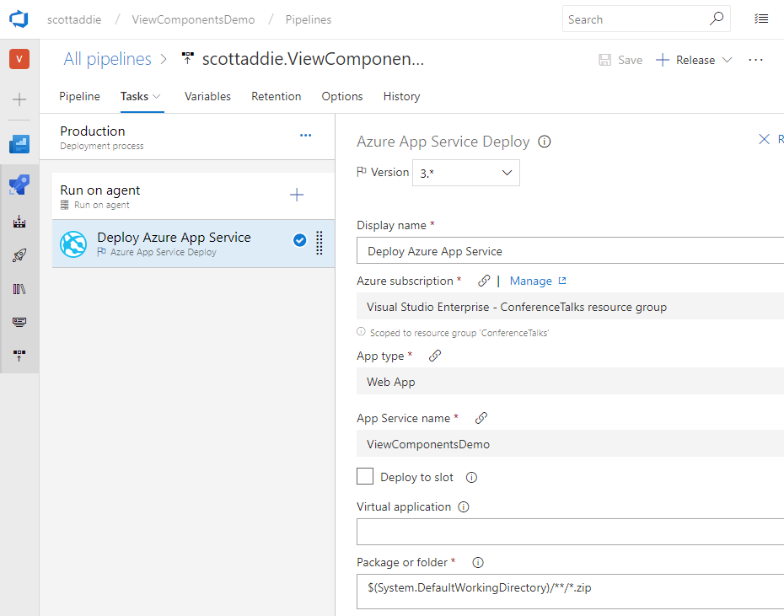
Release pipeline

Slide 21
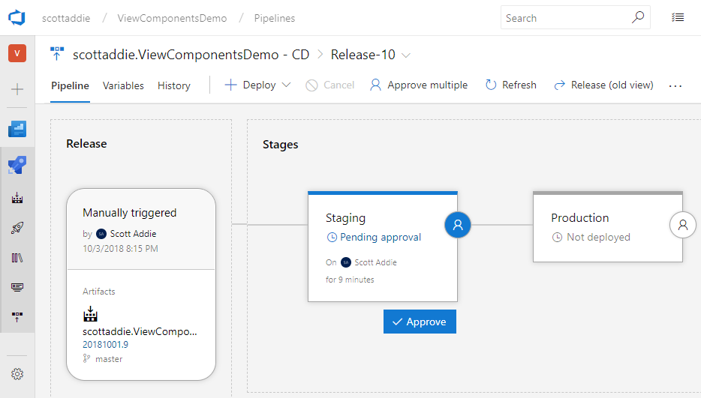
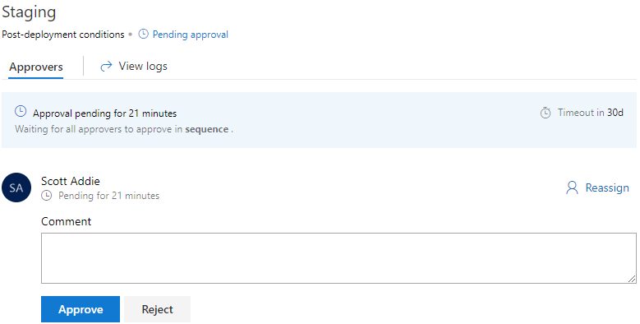
Blue-green deployments
Reduce downtime & risk
Request stakeholder sign-offs before deploying
Notes:
- 2 identical prod envs.
At any time, only 1 of the envs. is live
Swap envs.
Blue = live; Green = idle
Easily roll back, if something goes
- Use deployment slots (S1 tier and above)

Slide 22
Azure Pipelines
#AzureDevOps
Demo

Slide 23
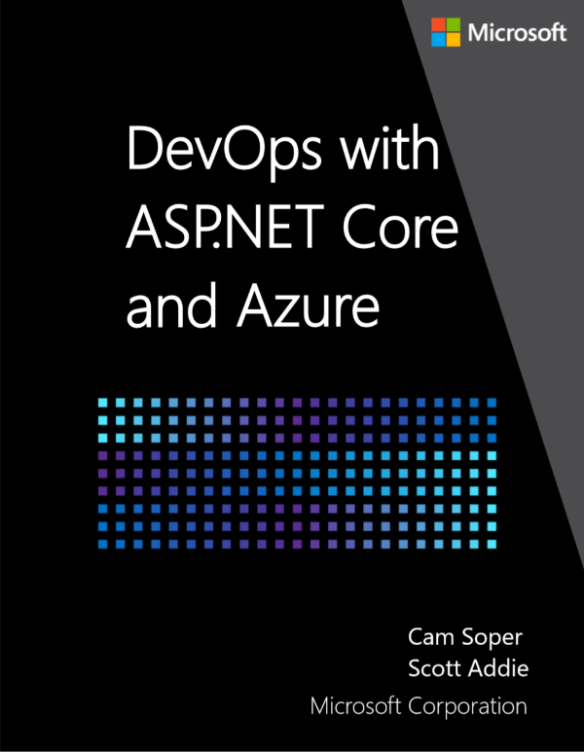

Resources @Scott_Addie
Docs
eBook
Slides
Code
➔
docs.microsoft.com/azure/devops/pipelines
➔
aka.ms/aspnetdevops
➔
aka.ms/aspnet-devops-slides
➔
github.com/scottaddie/ViewComponentsDemo

